Slide 1
Design and Implementation of a High Power Density GaN-Based USB-PD Charger
Bugra ER¹, Gorkem BAVTAR², Omer Cihan KIVANC³
^{1,2} SANEL Auto Electronics Istanbul, Turkey,
³ Electrical and Electronics Engineering Istanbul Okan University Istanbul, Turkey

Slide 2
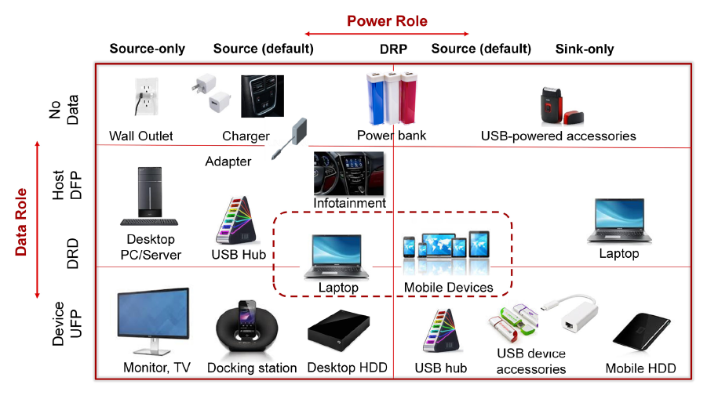



ABSTRACT
We present the design of a 100W GaN-based USB-PD charger with high power density.
GaN technology provides higher efficiency, less switching loss, and compact size compared to silicon.
We analyzed different power topologies and GaN-based to find the best thermal and electrical performance.
Thermal tests under full load showed excellent heat management and efficiency.
Results prove GaN is ideal for next-gen fast chargers in consumer electronics.
Design and Implementation of a High Power Density GaN-Based USB-PD Charger – Bugra ER

Slide 3


I. INTRODUCTION
GaN technology offers high efficiency, high frequency, and power density—replacing silicon in power electronics.
Ideal for USB-PD chargers: smaller, lighter, and more energy-efficient designs.
GaN FETs switch faster, reduce losses, and improve overall performance.
Especially valuable in automotive applications where size and heat are critical.
Challenges include cost, availability, and USB-PD compatibility.
Literature focuses on topology, thermal design, and EMI solutions for GaN-based chargers.
Design and Implementation of a High Power Density GaN-Based USB-PD Charger – Bugra ER

Slide 4
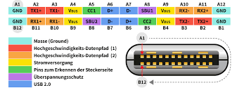
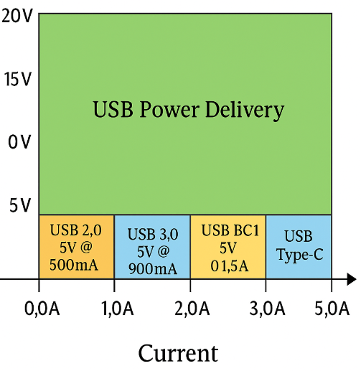
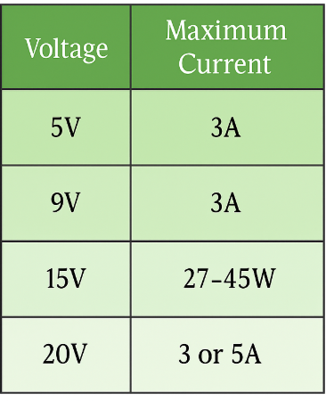
LITERATURE REVİEW
CCM totem-pole PFC improves efficiency (98.6%) and reduces EMI filter size with 90 W/in³ power density[5] .
A 140W prototype with wide voltage range (5–28V) and ZVS/ZCS switching improves power factor[6] .
240W design with USB-PD EPR (5–48V) achieves up to 97% efficiency [7] .
LLC resonant converter for aerospace use shows >90% efficiency and 73.2 W/in³ density[8] .
Dual USB-C GaN charger meets EMI standards and achieves 1.9 W/cm³ without buck stage[9] .
Studies focus on integrated control, size vs. efficiency trade-offs, and fast transient response[10–12] .
Design and Implementation of a High Power Density GaN-Based USB-PD Charger – Bugra ER

Slide 5
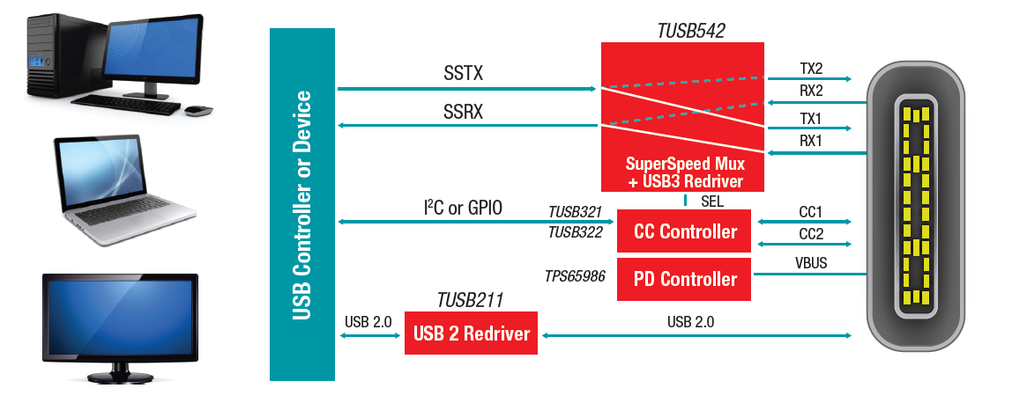
Peak efficiency: 96.1%
Fast load response:
0.5 A → 5 A: 10.7 µs, 133 mV undershoot
5 A → 0.5 A: 9.4 µs, 147 mV overshoot
Supports USB-PD protocol with communication for:
Voltage negotiation (5V, 9V, 15V, 20V)
Current limits
Protection features
Uses PD controllers and buck-boost topology for flexible power delivery
GaN technology enables:
High power density (100W)
Low switching losses
Compact and thermally stable design
Fully tested under thermal, electrical, and USB-PD communication conditions
Design and Implementation of a High Power Density GaN-Based USB-PD Charger – Bugra ER

Slide 6
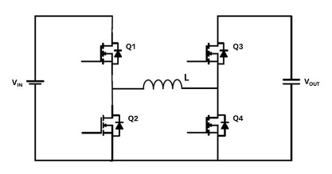
II. DESIGN APPROACH
Key design factors: Topology, integration, efficiency, power density, thermal performance, output current, and cost
RT6190 (buck-boost controller):
Wide input range (5–36V)
High efficiency
External FET support → good thermal control
RT1718S (USB-PD controller):
Full USB-PD 3.0 compliance
Manages voltage negotiation and protection
Communicates with the load (e.g. laptop, phone)
Selected RT6190 + RT1718S combo provides:
✔ High power delivery (up to 100W)
✔ Reliable USB-PD communication
✔ Cost-effective and compact design
✔ Stable performance across load/thermal conditions
MPQ4241:
Compact & low-cost
Supports buck only, not suitable for high power
MPQ4242:
Supports buck-boost, but limited to 3A
No external FET support → not ideal for high power
Dual-port designs (e.g., MPF52001 + MPQ4214/4263):
Flexible and USB-PD compatible (≈60W)
Higher complexity and cost
Design and Implementation of a High Power Density GaN-Based USB-PD Charger – Bugra ER

Slide 7
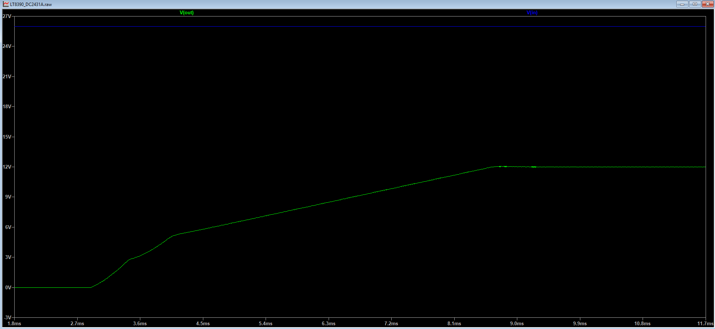
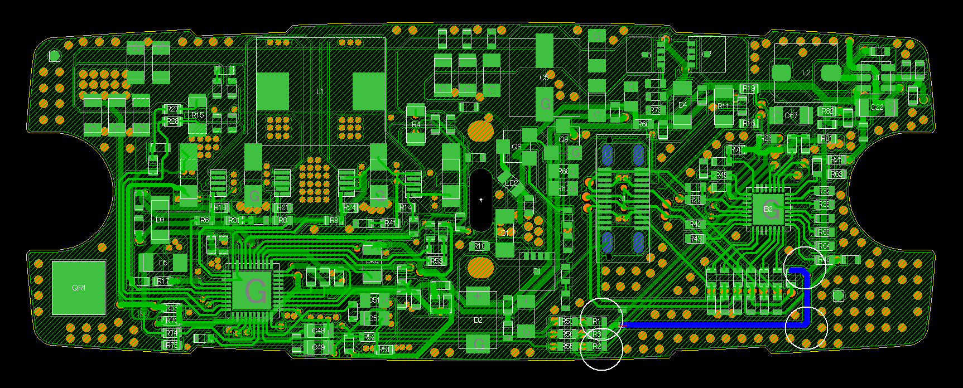
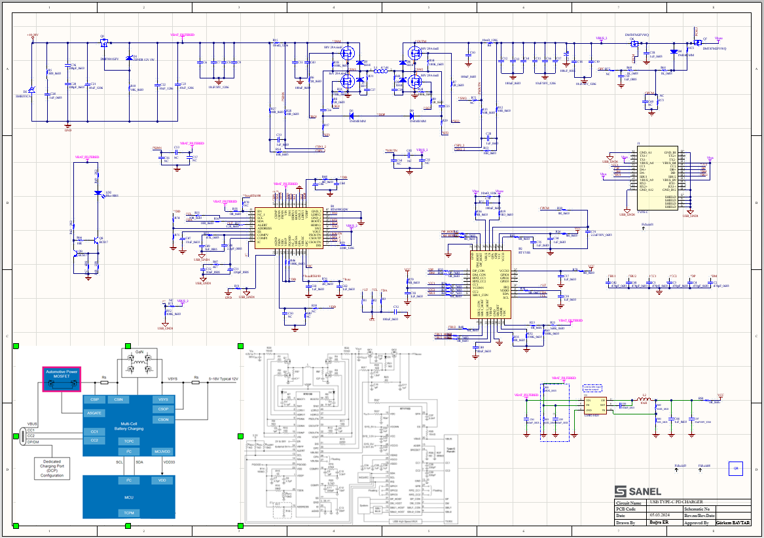
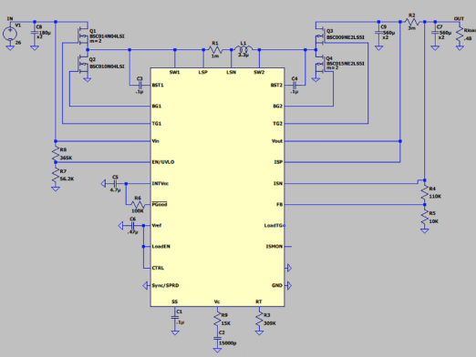
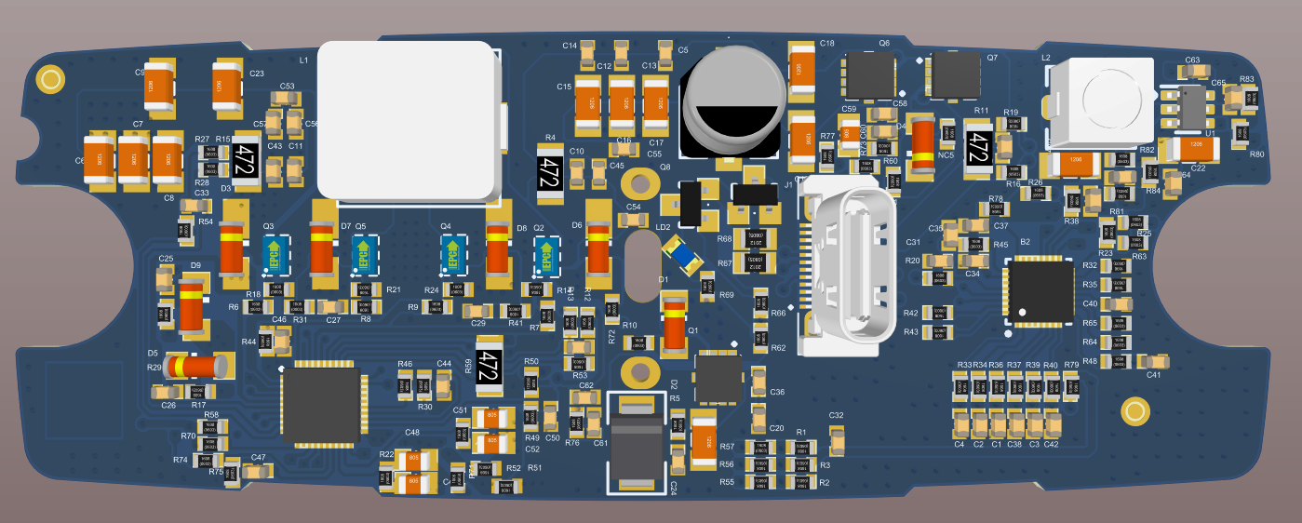
RT6190 + RT1718S selected for:
USB-PD 3.0 support
Wide input range (5–36V)
High efficiency with external FETs
Low complexity, cost-performance balance
GaN vs. Silicon (EPC2218 vs. DMTH6005):
GaN: Fast switching (1–2 ns), low Rds(on), low capacitance → better efficiency & size
Silicon: Higher current, but slower and less efficient at high frequency
Design steps:
Schematic design based on RT6190 + EPC2218 topology
Signal simulations (deadtime, ringing, switch behavior)
PCB layout optimized for thermal and EMI performance
Resonant plane analysis used to minimize high-frequency noise and improve power integrity
Design and Implementation of a High Power Density GaN-Based USB-PD Charger – Bugra ER

Slide 8
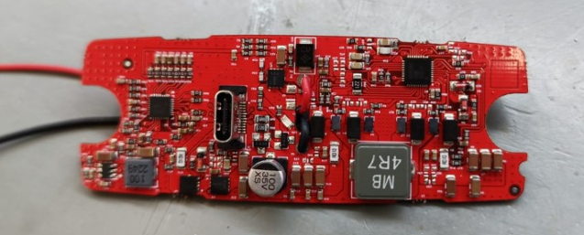
Overall, the literature underscores that while several component configurations are available, the selection ultimately depends on a trade-off among efficiency, design complexity, cost, and specific application requirements. The RT6190 + RT1718S combination, along with GaN-based devices like the EPC2218, appears to provide a balanced and optimized solution, particularly for designs demanding high efficiency, flexibility, and compactness in USB-PD charger applications.
Prototyped GaN based USB-PD charger.
Design and Implementation of a High Power Density GaN-Based USB-PD Charger – Bugra ER

Slide 9
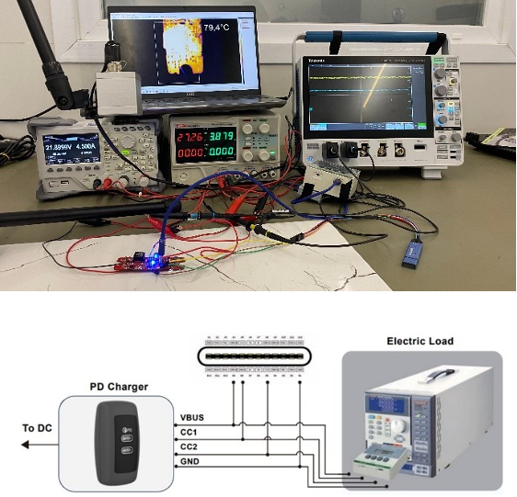
III. EXPERIMENTAL RESULTS
Component selection focused on: ✔ Efficiency ✔ Thermal durability ✔ Power density ✔ Output capacity ✔ Cost
Key elements:
RT6190 buck-boost controller
EPC2218 GaN FETs for fast switching and thermal performance
Buck-boost topology ensures stable output (5V–36V input)
Test setup includes:
GaN-based USB-PD charger prototype
Measurement interface (voltage, current, temp points)
Programmable electronic load for full-load testing
Ready for performance, thermal, and USB-PD behavior evaluation
Experimental test-bed.
Design and Implementation of a High Power Density GaN-Based USB-PD Charger – Bugra ER

Slide 10
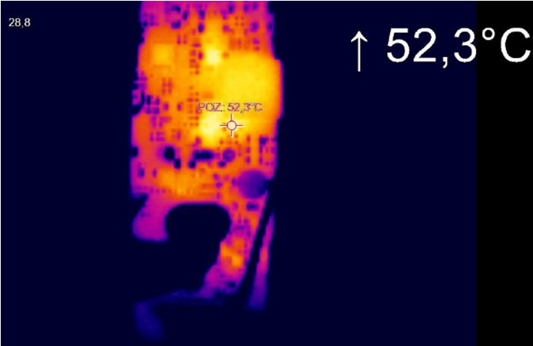
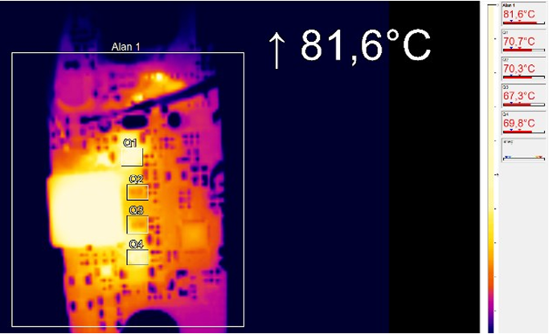
Thermal Test Summary: The temperature behavior of critical components such as the RT6190 controller and EPC2218 GaN FETs was tested under ISO 16750-2 thermal stress conditions. These included:
High temperature: 85°C, Low temperature: -40°C
Thermal cycling: 100 cycles between 85°C ↔ -40°C
Rapid thermal change: 100°C/s rate
Key Results: At 45W output: 52.3°C, Automotive stress condition: 55°C, Full load (100W): 81.6°C
All components remained stable throughout the tests, proving the charger meets ISO 16750-2 requirements. The design ensures thermal durability and reliability for long-term use in automotive environments.
Thermal analysis result under 45 W load.
Thermal analysis result under full load (100 W).
Design and Implementation of a High Power Density GaN-Based USB-PD Charger – Bugra ER

Slide 11
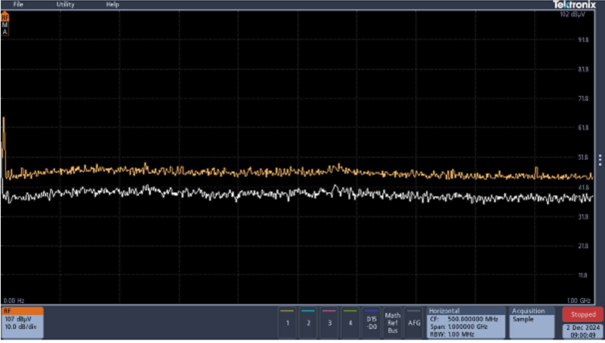
EMC Test Summary:
Electromagnetic compatibility (EMC) tests were conducted to ensure the 100W USB-PD charger meets ECE R10 automotive standards.
Both conducted and radiated emissions stayed within required limits.
For the 45W buck-boost configuration, high-frequency EMI was mitigated by increasing input/output capacitors.
The input filter was optimized to keep emissions below –50 dBµV in the 150 kHz–30 MHz range.
Results confirm compliance with automotive EMC requirements, shown in Fig. 5.
Fig. 5. Electromagnetic compatibility result.
Design and Implementation of a High Power Density GaN-Based USB-PD Charger – Bugra ER

Slide 12
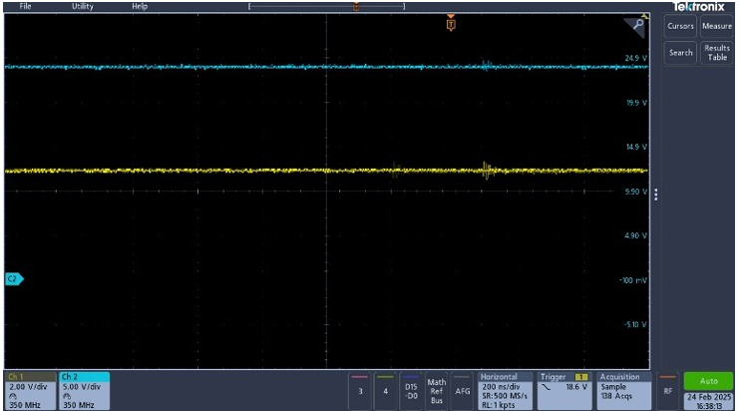
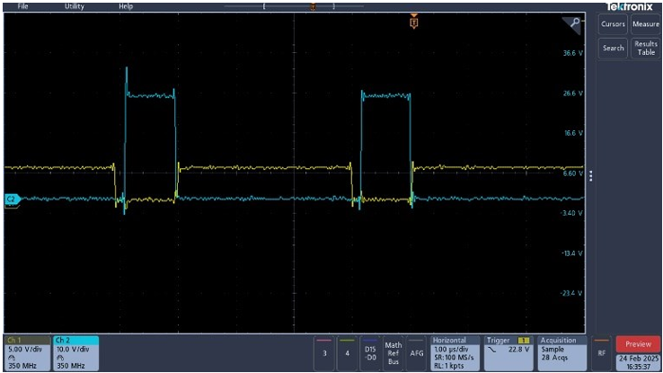
Switching Behavior & Output Quality:
In the half-bridge circuit using RT6190 and GaN FETs, special attention is given to prevent simultaneous switching of high-side and low-side transistors.
A deadtime is introduced to avoid shoot-through conditions.
Ringing, caused by fast GaN switching, is observed but controlled to reduce EMI and losses.
Ripple analysis with an oscilloscope shows:
<20 mV ripple at 5V & 9V, <30 mV ripple at 15V & 20V
Output waveforms and switching details are shown in Fig. 6 and Fig. 7.
Fig. 6. Output voltage (blue) and current (yellow) under full load.
Fig. 7.
High side and low side drain-source voltage.
Design and Implementation of a High Power Density GaN-Based USB-PD Charger – Bugra ER

Slide 13
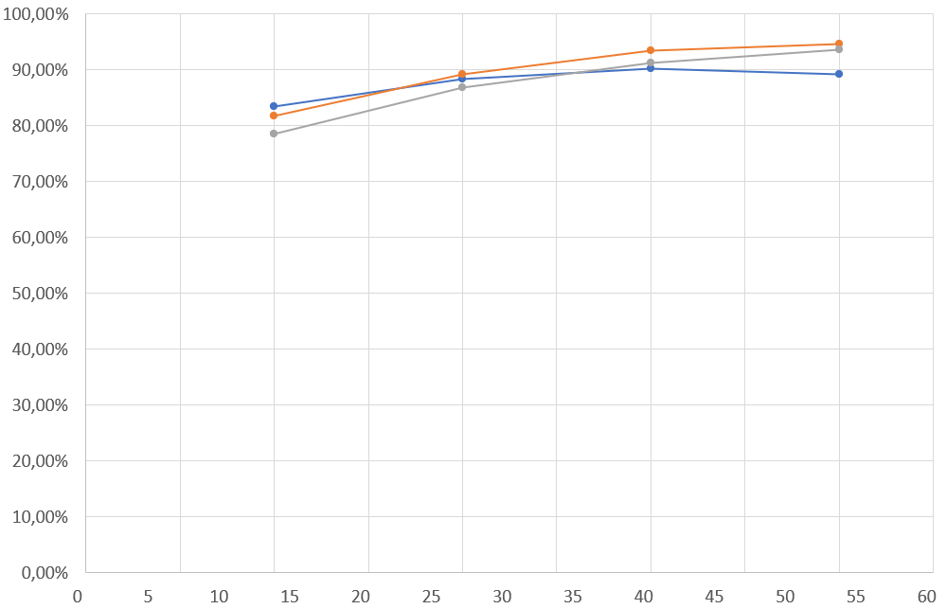
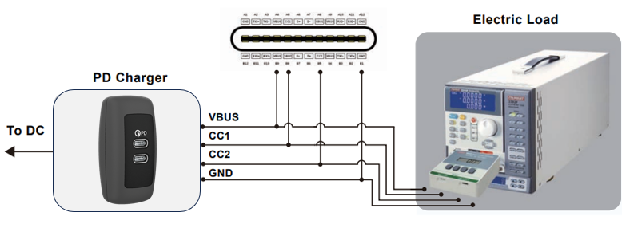
IV. CONCLUSION
A 100W GaN-based USB-PD charger was successfully designed, prototyped, and tested.
GaN technology provided high efficiency, low switching losses, and excellent thermal performance.
Tests confirmed:
Stable operation under full load
Safe temperatures and minimal ripple voltage
Compared to silicon-based solutions, the GaN design offered:
Higher power density
Better efficiency
Ideal for next-generation fast-charging applications.
Future work: Focus on thermal optimization, EMI reduction, and further miniaturization
Design and Implementation of a High Power Density GaN-Based USB-PD Charger – Bugra ER

Slide 14
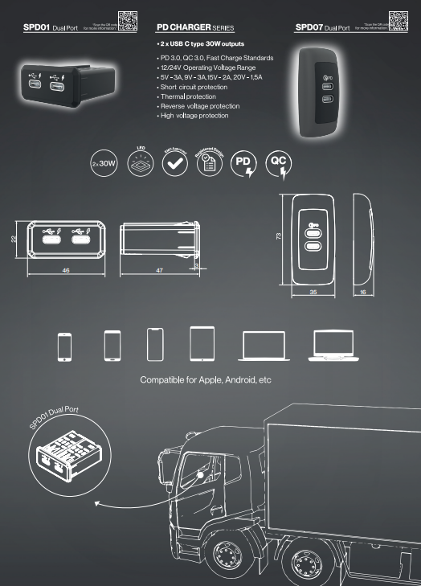
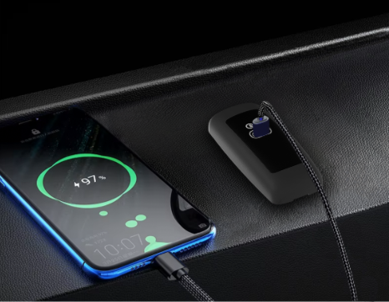
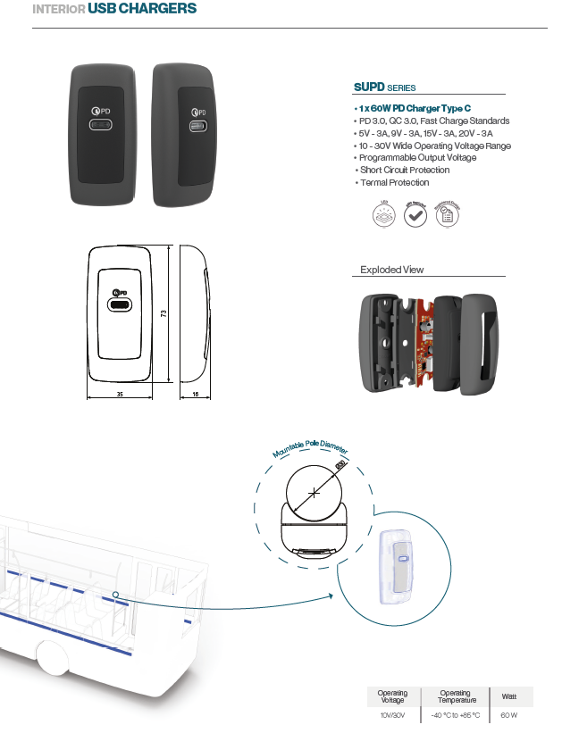

**ACKNOWLEDGMENT This work is supported by The Scientific and Technological Research Council of Turkey (TUBITAK) funded project (3240308).
Design and Implementation of a High Power Density GaN-Based USB-PD Charger – Bugra ER

Slide 15
Thank You…
Bugra ER
bugra.er@sanel.com.tr

